Slide 1





ZENITH’24
Domain: AI/ML
Crafting an end-to-end "MUNCHIEMASCOT" - Your Personal Culinary AI Companion in Recipe Generation.
Team Name: GenX H4CK3RS!

Slide 2
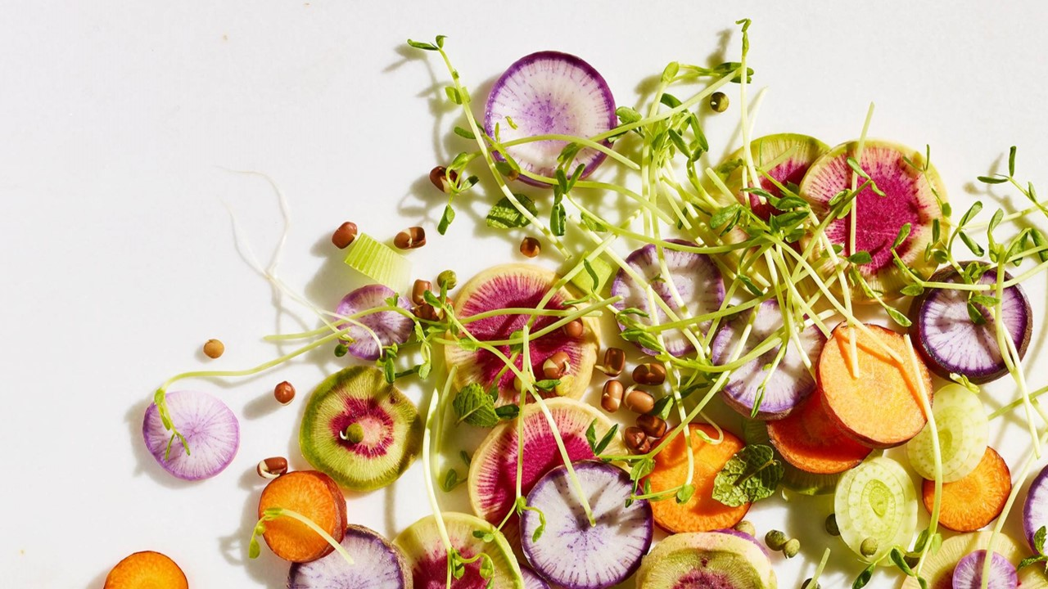

ZENITH’24

Slide 3

Team Member Details
NAME | Jayadithya G | U. Pranov Shanker | Rohit K Manoj
Branch/Deptmt. | B-Tech CSE Cybersecurity [Batch 2023-2027] | B-Tech CSE Internet of Things[IOT] [Batch 2023-2027] | B-Tech CSE Internet of Things[IOT] [Batch 2023-2027]
Year/College | 1st ^{SNU} | 1st ^{SNU} | 1st SNU
Email-Id | jayadithya23110418@snuchennai.edu.in | pranov23110262@snuchennai.edu.in | rohit23110492@snuchennai.edu.in
Registration no. | 23011103019 | 23011102110 | 23011102073

Slide 4
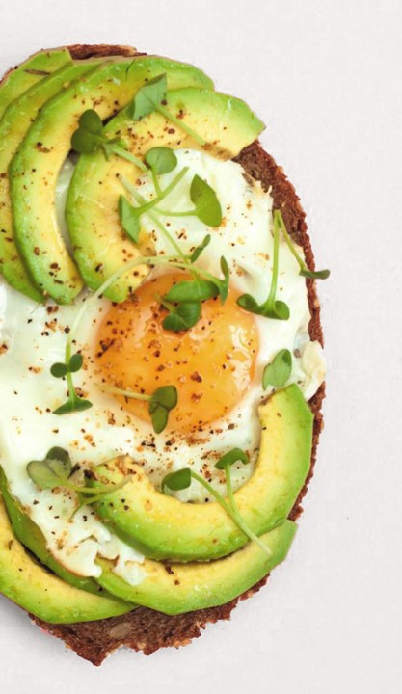
Explaining the code that we used for reading from csv file ("RAW_recipes.csv") - The code that’s implemented for preprocessing, tokenizing, optimizing and training for 15 epochs.
Here the RAW-recipes.csv contains considerably a large amount of recipes in its dataset obtained from Kaggle.
Based upon the dataset we have implemented the code to implement the following operations:-
Pre-processing of the dataset :- (uses the file glove.6B.100d.txt)
glove.6B.100d.txt is a file containing pre-trained GloVe (Global Vectors for Word Representation) word embeddings. GloVe is an unsupervised learning algorithm for obtaining vector representations for words, which can be used as input to deep learning models for natural language processing tasks. The glove.6B.100d.txt file specifically contains word embeddings trained on a corpus of 6 billion tokens (6B) with a vector dimension of 100 (100d). These pre-trained word embeddings capture semantic and syntactic relationships between words, which can help improve the performance of NLP models by providing meaningful numerical representations of words as input.

Slide 5
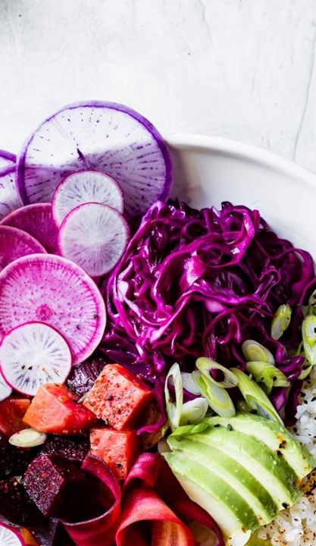
Import csv.py :-
This code is designed to help create a model that understands and generates recipes based on text input. It starts by reading a CSV file containing recipe data. Then, it preprocesses this data, combining the steps and ingredients into one text corpus.
To teach the model to understand different intents related to recipe discussion, like greetings, asking for recipes, or talking about dietary restrictions, it defines a set of intents and their associated keywords.
Next, it tokenizes the text, which essentially means breaking down the text into smaller parts to make it easier for the model to understand. Then, it creates a neural network model using TensorFlow and Keras libraries. This model learns from the recipe text data and tries to predict the intent behind a given text.
Finally, it trains the model on the recipe data, using a technique called transfer learning to leverage pre-trained word embeddings (GloVe) for better understanding of the recipe text. After training, the model can be used to understand and respond to various recipe-related queries or generate new recipes based on input.

Slide 6
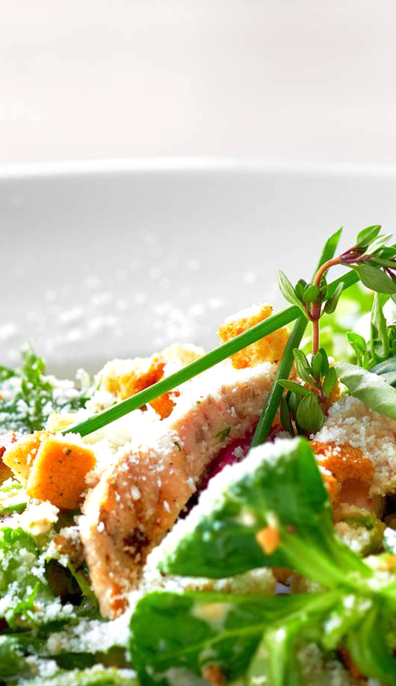
About the libraries, frameworks and fucntions used in the code :-
Libraries and Frameworks Used:-
Pandas:-
Used for data manipulation and analysis, particularly for handling the CSV data.
NumPy:-
Fundamental package for scientific computing in Python, used for numerical operations and handling arrays.
scikit-learn:-
A machine learning library for various tasks like data preprocessing, model selection, and evaluation.
TensorFlow and Keras:-
TensorFlow is an open-source machine learning framework for building and training models. Keras is a high-level neural networks API that runs on top of TensorFlow, designed for fast experimentation with deep neural networks.

Slide 7
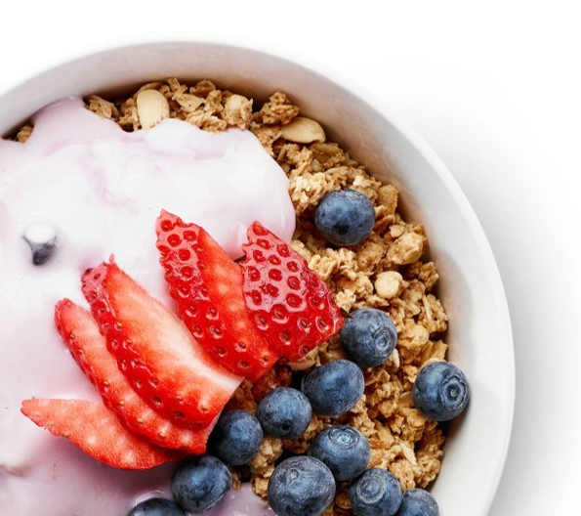
Functions Used inside the code:
read_csv_with_errors():
Custom function to read a CSV file with error handling.
Tokenizer():
Converts text to tokens, which are numerical representations of words.
pad_sequences():
Pads sequences to a fixed length, ensuring uniform input size for the neural network.
to_categorical():
Converts class labels to one-hot encoded vectors, necessary for multi-class classification.
fit():
Trains the model on the training data.
evaluate():
Evaluates the trained model on the testing data to assess its performance.

Slide 8
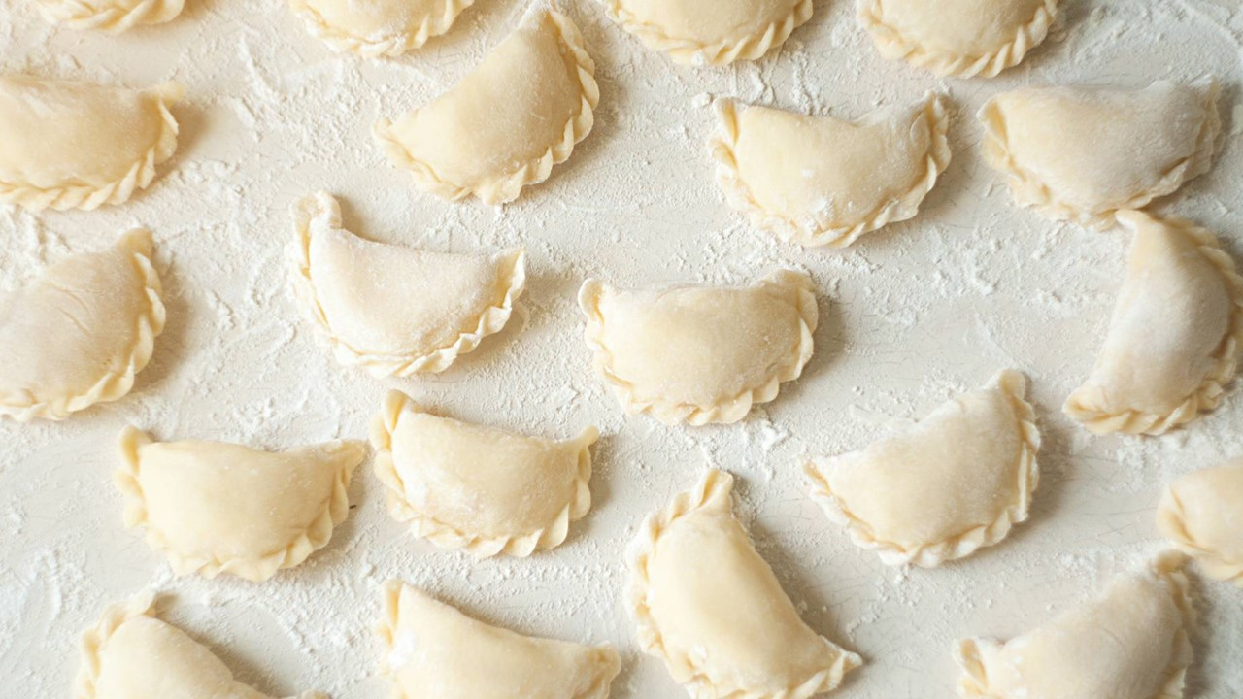
Model Architecture:- Sequential(): Defines the model as a linear stack of layers. Embedding(): Layer for word embeddings, which convert words into dense vectors. Conv1D(): 1D convolutional layer for feature extraction from sequences. MaxPooling1D(): Performs max pooling operation for downsampling input along the time dimension. Dropout(): Regularization technique to prevent overfitting by randomly dropping neurons during training. Flatten(): Flattens the input, converting multi-dimensional data into a 1D array. Dense(): Fully connected layer with specified number of neurons. Activation functions: Functions applied to introduce non-linearity into the network, such as relu (Rectified Linear Unit) and softmax.

Slide 9
Training:-
compile():-
Configures the model for training, specifying the optimizer, loss function, and metrics to monitor.
fit():
Trains the model on the training data for a fixed number of epochs and batch size, while also validating on a separate testing set.
Epoch:-
In the context of machine learning, an epoch is like a full pass through a recipe book during cooking practice.
Each epoch represents one complete iteration over the entire dataset during training. Just as you might repeat a recipe book multiple times to improve your cooking skills, multiple epochs help the model learn and improve its performance.
.

Slide 10
Implementing code for graph plots- accuracy check and loss check
-[A tradeoff, which we have to manage every time]
This code defines a function called plot_metrics which takes a history object as input. This history object typically contains the metrics (like loss and accuracy) recorded during the training of a neural network model.
The history object contains information about how our model performed during training. It stores metrics such as loss and accuracy for both the training and validation sets at each epoch.
The plot_metrics function takes this history object as input and creates two plots based on the recorded metrics:
The first plot shows how the training loss and validation loss change over epochs. This helps us understand how well our model is learning from the data.
The second plot illustrates how the training accuracy and validation accuracy evolve over epochs, indicating how accurately our model predicts intents.
These plots give us insights into the training process, helping us analyze how effectively our model learns and how well it generalizes or responds to unseen data.

Slide 11
Loss Plot:-
It plots the training loss and validation loss over epochs. This helps visualize how well the model is learning. If both losses decrease and converge, it indicates the model is learning effectively.
This shows how the loss (or error) of our model changes during training and validation. A decreasing trend indicates that the model is improving in understanding the recipe text and predicting intents accurately
Accuracy Plot:-
It plots the training accuracy and validation accuracy over epochs. This helps visualize how accurately the model is making predictions. If both accuracies increase and converge, it indicates the model is performing well on both the training and validation data.
This illustrates how accurately our model predicts recipe intents over epochs. An increasing trend in both training and validation accuracies indicates that our model is getting better at identifying intents correctly.
These plots help in understanding the training progress and performance of the model. Finally, the function displays these plots using Matplotlib's plt.show() method.

Slide 12
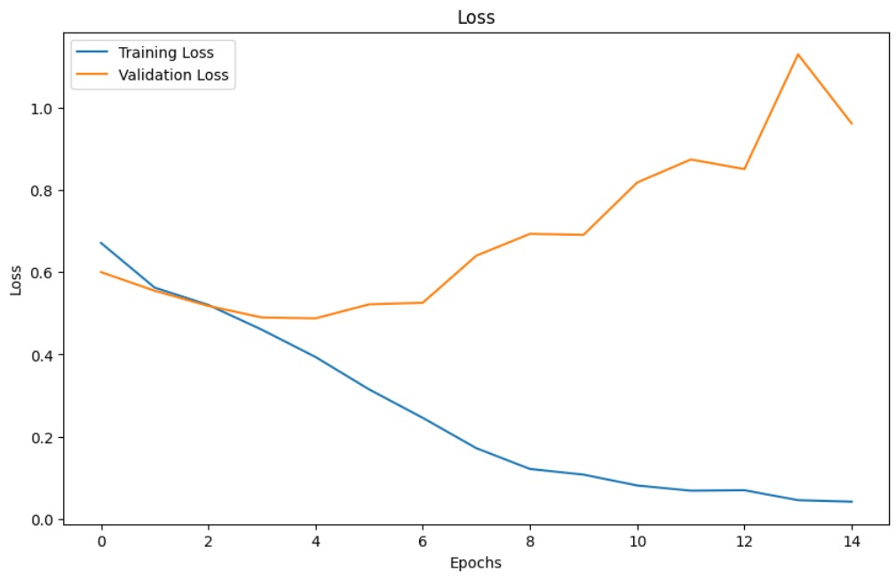

Slide 13
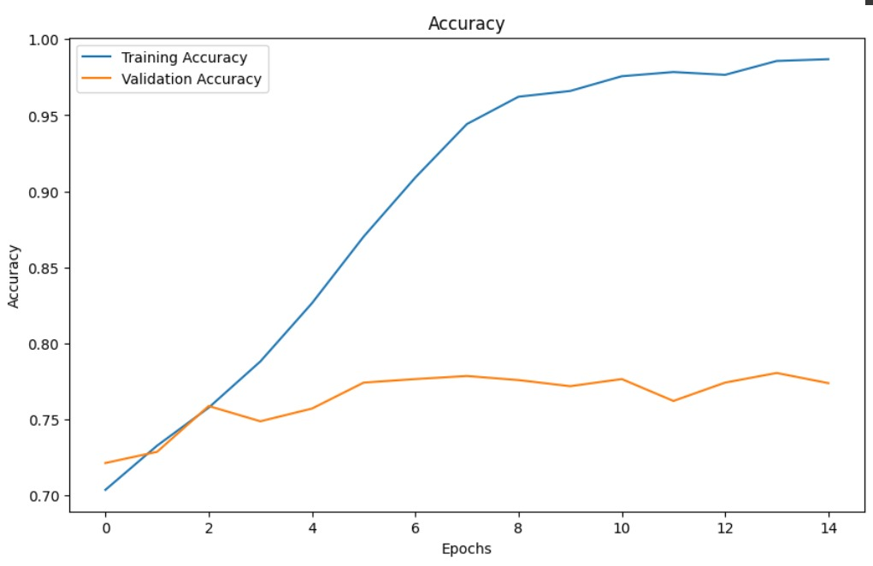
Accuracy achieved - 98%:-

Slide 14
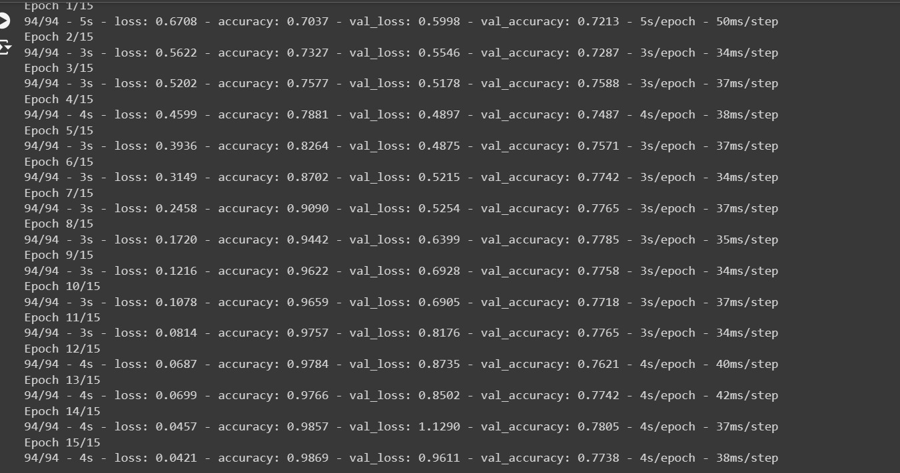
Model Training at each Epoch:-

Slide 15
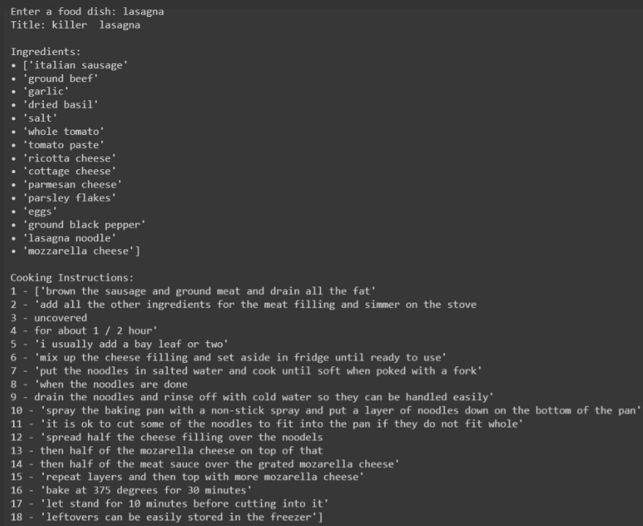
Sample Recipe generation output after training:-

Slide 16
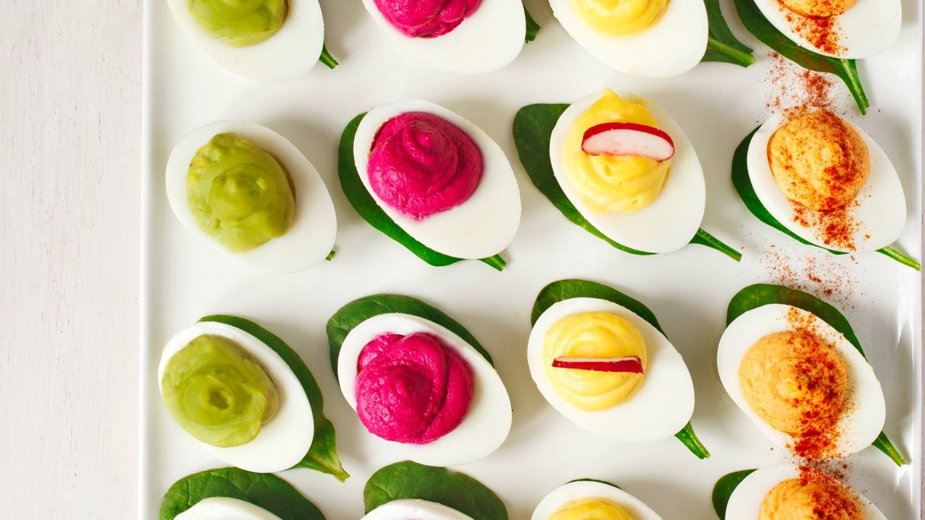


Slide 17

THANK YOU ALL!

